Slide 1
COURSE OVERVIEW

Slide 4
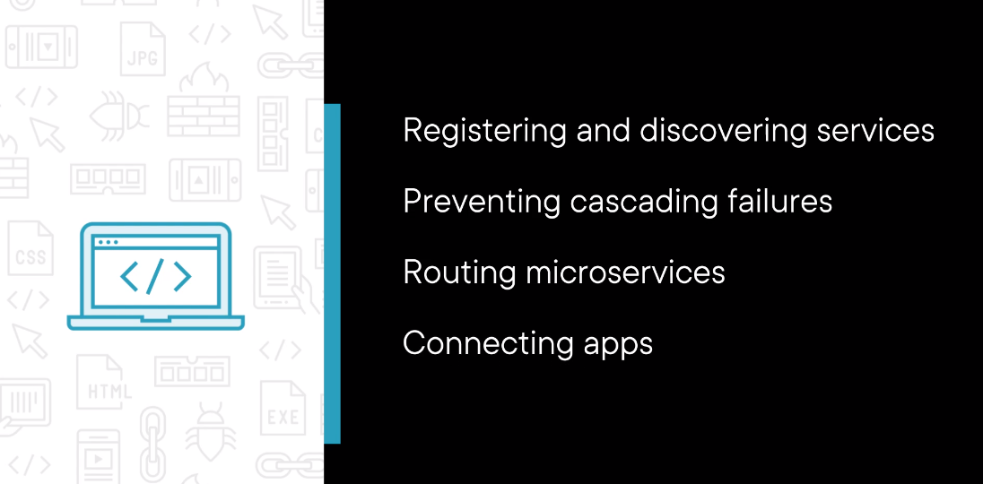

Slide 5


